Slide 1
Computer Input/output System
2019
Instructors: Yang Quansheng
School of Computer Science and Engineering
College of Software Engineering
Southeast University

Slide 2
Chapter 3:
The Basic of I/O

Slide 3
Outline
I/O Module
Principal I/O techniques
The type of the I/O address space.
8086/8088 Hardware
Personal Computer I/O Map
I/O Port Address Decoding

Slide 4
3.1 I/O Module
What is I/O module
  The computer’s I/O modules is its interface to the outside world.
  Each module interfaces to the system bus or central switch and control one or more peripheral devices.
  The I/O module contains logic for performing a communication function between the peripheral and bus.
Address Bus（AB）
Data Bus（DB）
System
Bus
CPU
Control Bus（CB）
Peripheral device
I/O Module
Peripheral device
Peripheral device

Slide 5
3.1 I/O Module
Why one does not connect peripherals directly to the system bus? (Why an I/O module is needed?)
  There are a wide variety of peripherals with various methods of operation.
  The data transfer rate of peripherals is often much slower than that of the memory or processor.
  On the other hand, the data transfer rate of some peripherals is faster than that of the memory or processor.
  Peripherals often use different data format and word lengths than the computer to which they are attached.

Slide 6
3.1 I/O Module
I/O module Function
  Control and timing
    To coordinate the flow of traffic between the system BUS and peripherals.
  Processor communication
    Command decoding. Accepts commands on control bus from the processor and decode them.
    Data transfer. Exchange the data between the processor and I/O module.
    Status reporting. Transfer the status of the I/O module and peripherals to the system bus.
    Address recognition. I/O module must recognize one unique address for each peripheral it controls.

Slide 7
3.1 I/O Module
I/O module Function
  Device communication
    Control signals. Determine the function that the device will perform, such as:
      Send data to the peripheral.(OUTPUT)
      Accept data from the peripheral.(INPUT)
      Device report status, or I/O module perform some control function particular to the device.
    Data transfer. In the form of a set of bits to be sent or received from the peripheral.
    Status signals. Indicate the state of the device.
  Data buffering
    The data is buffered(by latch) in the I/O module and then send to device at its rate.
  Error detection and reports error to the processor

Slide 8
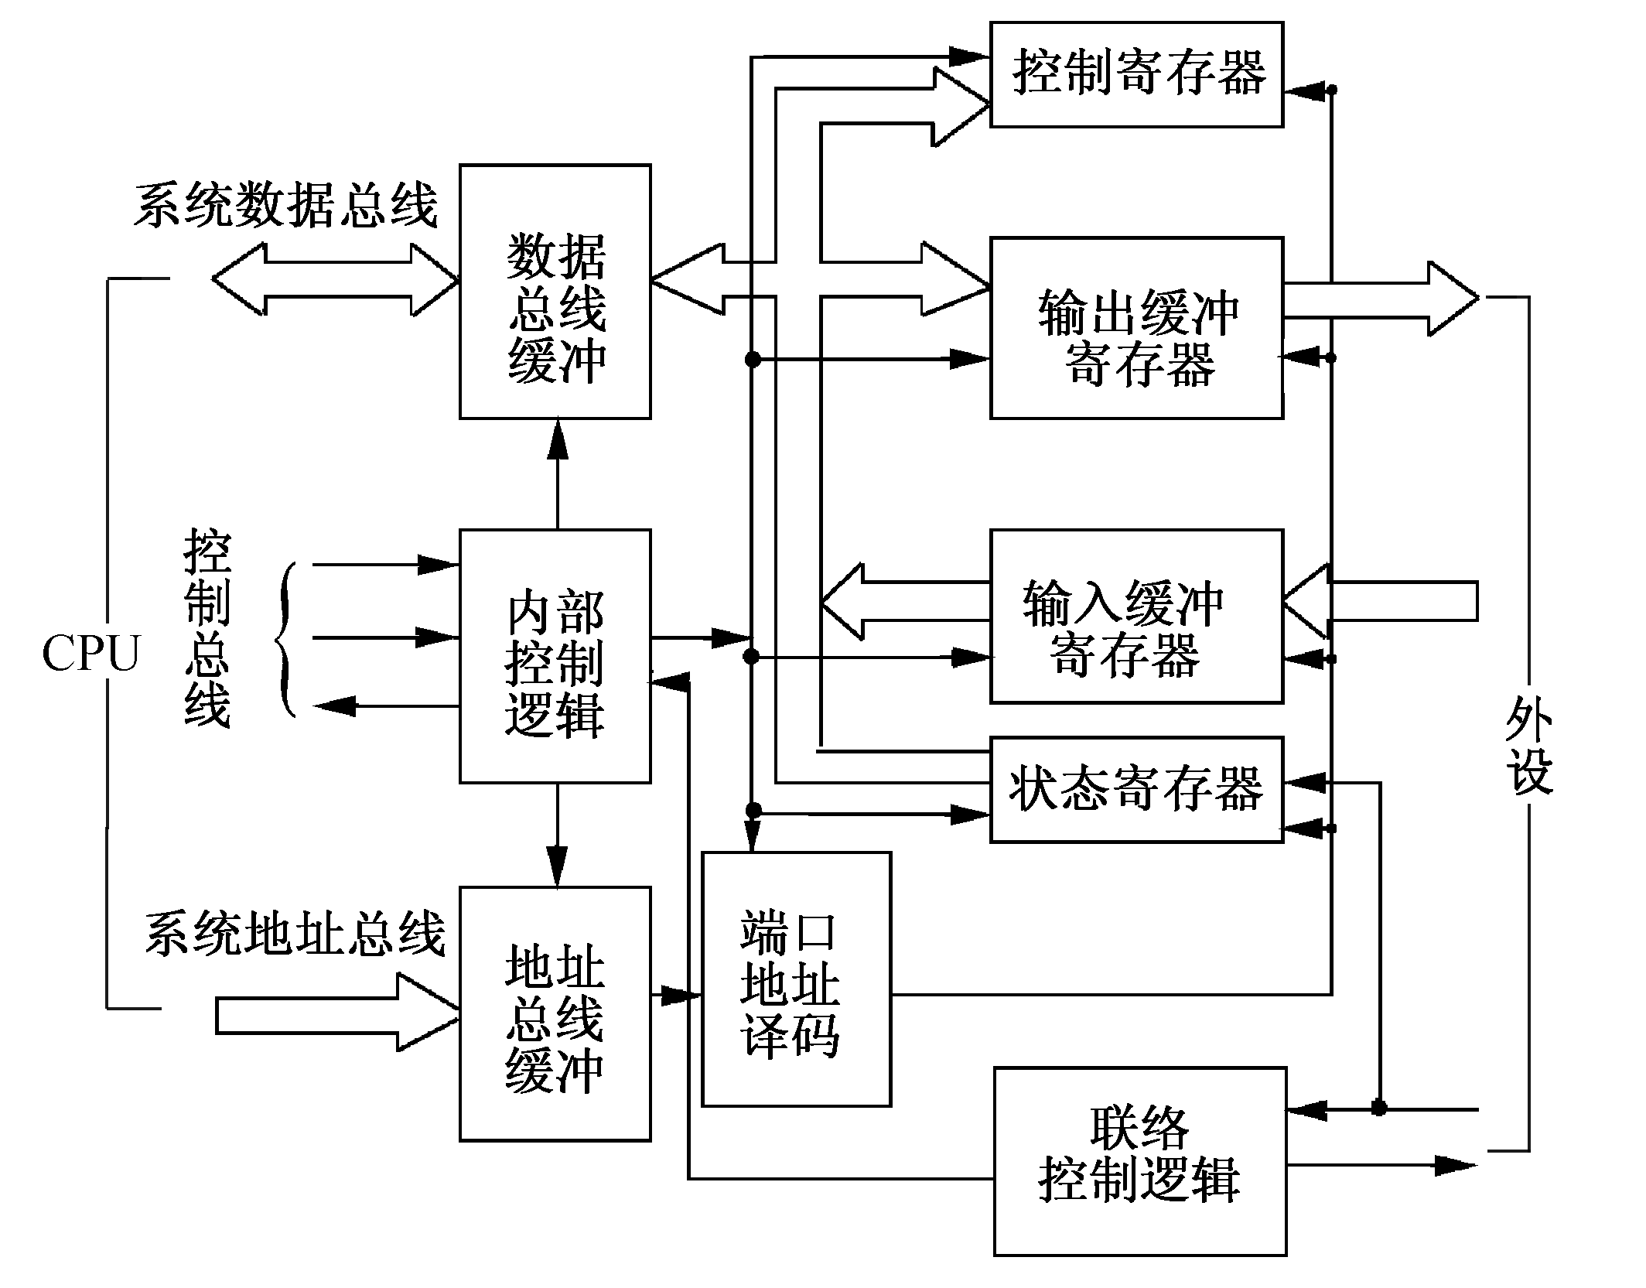
3.1 I/O Module
I/O module Structure
Control Register
System DB
Data
bus
buffer
Output
buffer
System CB
Internal
Control
Logic
Input
buffer
Status Register
Peripheral
Port
Addr.
decoder
System AB
Addr.
bus
buffer
Contact
Control
Logic

Slide 9
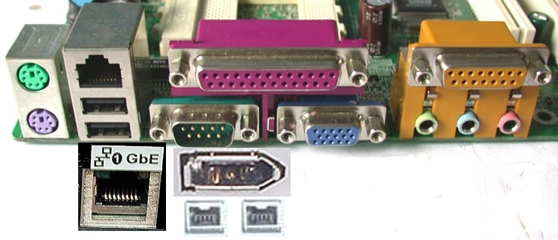
3.1 I/O Module
Common interface slot 1
MIDI/Game Port
10/100M NIC
PS2 mouse
Parallel Port
Serial Port
PS2
keyboard
Speaker /Line in /MIC Interface
1394
Gigabit Ethernet
USB
VGA Interface
1394a

Slide 10
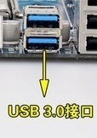
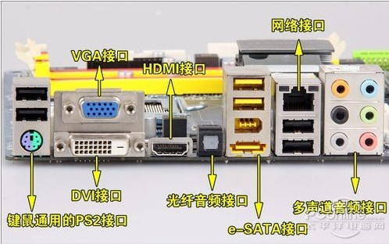
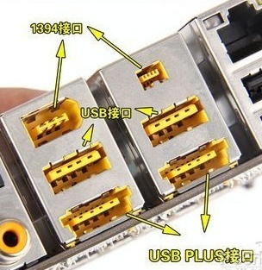

3.1 I/O Module
Common interface slot 2
Center and Subwoofer
Input channel
Rear speaker output
Front speaker output
Side speaker output
MIC input
Notes:
VGA、DVI和HDMI都是视频接口，用于连接显示器。VGA是传输模拟信号，DVI和HDMI能传输数字信号，支持1080P全高清视频。与DVI相比，HDMI主要优势是能够同时传输音频数据，在视频数据的传输上没有差别。另外，还有一种新兴的视频接口叫“DisplayPort”接口，简称DP接口，同样能够传输音频。
上图中还有一个光纤音频接口，很多朋友仅知道是光纤接口，但不知做什么用的，是否能插光纤网线？答案是否定的。该接口仅为高端音频设备传输音频信号。
e-SATA并不是一种独立的外部接口技术标准，简单来说e-SATA就是SATA的外接式界面，拥有e-SATA接口的电脑，可以把SATA设备直接从外部连接到系统当中，而不用打开机箱，但由于e-SATA本身并不带供电，因此也需要SATA设备也需要外接电源，这样的话还是要打开机箱，因此对普通用户也没多大用处。
e-SATA上面是IEEE 1394接口，IEEE 1394接口最大的优势是接口带宽比较高，其在生活中应用最多是高端摄影器材，这部分应用人群本来就少；加上更多用户采用USB接口来传输储存卡上的数据。因此，对于绝大部用户来说，IEEE 1394接口也很少用上。
请注意，上图的下端两个接口并不是e-SATA，而是USB 2.0与e-SATA结合的USB PLUS接口，外观上比e-SATA更厚点。USB PLUS接口是爱国者2009年发布的，目的是解决e-SATA没有提供供电的缺陷。

Slide 11
3.2 Principal I/O techniques
Programmed I/O
Interrupt-Driven I/O
Direct Memory Access
I/O Channels

Slide 12
3.2 Principal I/O techniques
Programmed I/O
  When the processor is executing a program and encounters an instruction relating to I/O, it executes that instruction by issuing a command to the appropriate I/O module.
  With programmed I/O, the I/O module will perform the requested action.
  Then there are 2 different ways:
    Unconditional transfer
      we suppose the device is always ready.
      Processor do not care the status of I/O module
    Conditional transfer
      After perform the action, I/O module set the appropriate bits in the I/O status register.
      Processor periodically to check the status in I/O module until finds that the operation is complete.

Slide 13
3.2 Principal I/O techniques
Programmed I/O
  I/O command that an I/O module may receive when it is addressed by a processor
    Control: Used to active a peripheral and tell it what to do.
    Test: Used to test various status conditions associated with an I/O module and its peripherals.
    Read: Cause the I/O module to obtain an item of data from the peripheral and place it in an internal buffer. The processor can then obtain the data item by requesting that the I/O module place it on the data bus.
    Write: Cause the I/O module to take an item of data from the data bus and subsequently transmit that data item to the peripheral.

Slide 14
3.2 Principal I/O techniques
Programmed I/O
  The problem with programmed I/O is:
    That the processor has to wait a long time for the I/O module of concern to be ready for either reception or transmission of data.
    The processor , while waiting, must repeatedly interrogate the status of the I/O module.
    As a result, the level of the performance of the entire system is severely degraded.

Slide 15
3.2 Principal I/O techniques
Interrupt-Driven I/O
  Processor issue an I/O command to a module and then go on to do some other useful work.
  The I/O module will then interrupt the processor to request service when it is ready to exchange data with the processor.
  The processor then executes the data transfer, as before, and then resumes its former processing.

Slide 16

3.2 Principal I/O techniques
Interrupt-Driven I/O
  How Interrupt-Driven I/O do for input, for example
    The processor issues a READ command to I/O module, then goes off and does something else.
    The I/O module get the data from the device and latch them in buff, then interrupt the processor to require service.
    The processor saves the context of the current program and process the interrupt to read the word of data from the I/O module and stores it in memory or register.
    The processor restores the context of the program it was working on and resumes execution.
Please think about the case of output

Slide 17
3.2 Principal I/O techniques
Interrupt-Driven I/O
  Inherent drawbacks:
    The I/O transfer rate is limited by the speed with which the processor can test and service a device;
    The processor is tied up in managing an I/O transfer;
    a number of instructions must be executed for each I/O transfer.

Slide 18
3.2 Principal I/O techniques
Direct Memory Access
  When a processor wishes to read or write a block of data, it issues a command to the DMA module. Then the processor continues with other work.
  The DMA do the I/O operation to transfer the entire block of data directly to or from memory, without going through the processor.
  When the transfer is complete the DMA module send an interrupt to the processor.
  Thus, the processor is involved only at the beginning and end of the transfer or when the transfer has problem.

Slide 19
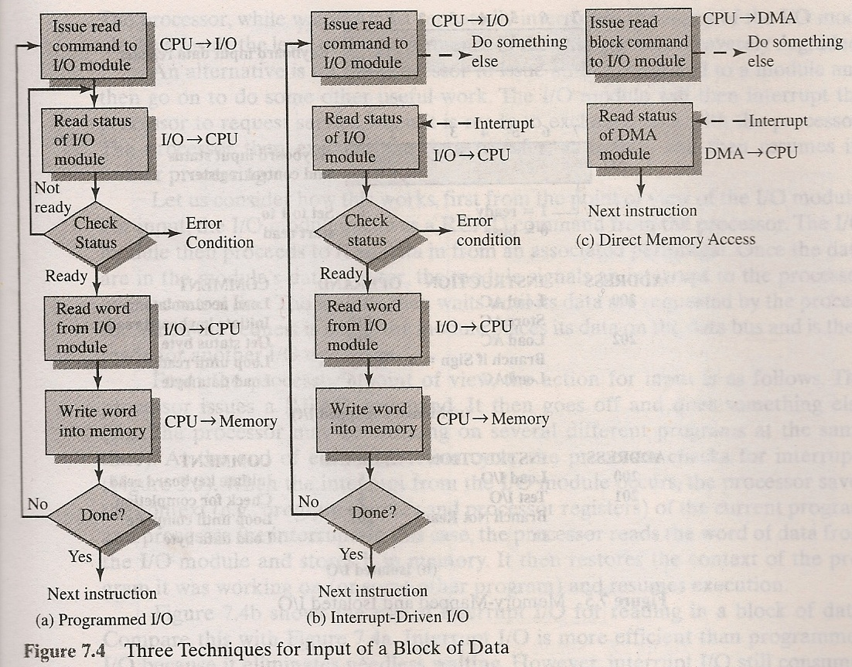
3.2 Principal I/O techniques

Slide 20
3.2 Principal I/O techniques
I/O Channels
  The I/O module is enhanced to become an processor in its own right, with a specialized instruction set tailored for I/O. This I/O module is often referred to as an I/O channel.
  The I/O channel has the ability to execution the I/O instructions, which gives it complete control over I/O operations.
  The CPU dose not execute I/O instructions, such instructions are stored in the main memory to be executed by a special-purpose processor in the I/O channel itself.

Slide 21
3.3 The type of the I/O address space
Isolated I/O
  The address for isolated I/O device, called ports address, is separate from the memory address space.
  The user can expand the memory to its full size without using any of memory space for I/O device.
  Disadvantage:
    Data transfer between I/O and CPU must be accessed by the specialized I/O instructions.
    Need specialized the
    control signal(M/IO,WR,RD)
  X86-based system used.
FFFFF
0
1MByte
FFFF
0
64kByte
Memory space
I/O space

Slide 22
3.3 The type of the I/O address space
Memory-Mapped I/O
  A memory-mapped I/O device is treated as a memory location in the memory map.
  Any memory transfer instruction can be used to access the I/O device. The specialize I/O instruction is no need.
  Disadvantage:
    A portion of memory system is used
    as the I/O device. This reduces the
    amount of memory available to
    applications.
N-1
K
K-1
0
I/O
MEM
Memory+I/O

Slide 23
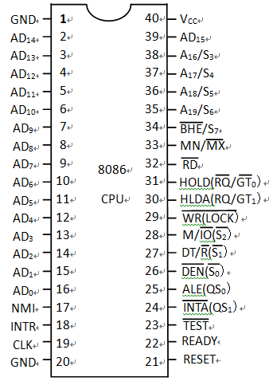
3.4 8086/8088 Hardware
Pin-outs and the Pin Function
8088 is A₁₅
8088 is
A₈~A₁₄
8088 is SSO(HIGH)
8088 is IO/M (S₂)

Slide 24
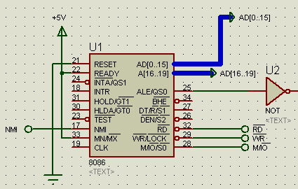
3.4 8086/8088 Hardware
Pin-outs and the Pin Function
  Minimum Mode
    Is the least expensive way to operate the 8086/8088
    All the control signals for the memory or I/O are generated by CPU.
    This mode operation is obtained by connected mode selection pin
    MN/MX to +5V.
    ALL our experiment base
    on minimum mode.

Slide 25
3.4 8086/8088 Hardware
Pin-outs and the Pin Function
  8086 pin we will use
    CLK : I, The clock pin provides the basic timing signal to the microprocessor.
    AD_{0~15} : O/IO, address/data bus. When ALE is 1, transfer the rightmost 16 bits of the memory address or I/O port number; when ALE=0, transfer the data. In 8088 is AD_{0~7} and A_{8~15}
    A_{16~19} : O, When ALE is 1, transfer the leftmost 4 bits of the memory address.
    M/IO* : O, when this signal is a logic 1, means the address bus contains the memory address, otherwise, it contains the I/O port number.
* A or A# means signal A is active when it is 0 value.

Slide 26
3.4 8086/8088 Hardware
Pin-outs and the Pin Function
  8086 pin we will use
    RD : O, When the read signal is a logic 0, the data bus is receptive to data from the memory or I/O device.
    WR : O, When the write signal is a logic 0, the data bus contains valid data that 8086 outputting to the memory or I/O device.
    ALE : O, Address latch Enable shows that 8086 AD₀₋₁₅ contains address information.
    INTR : I, Interrupt request is used to request a hardware interrupt.
    INTA : O, The interrupt acknowledge signal is a response to the INTR input pin.

Slide 27
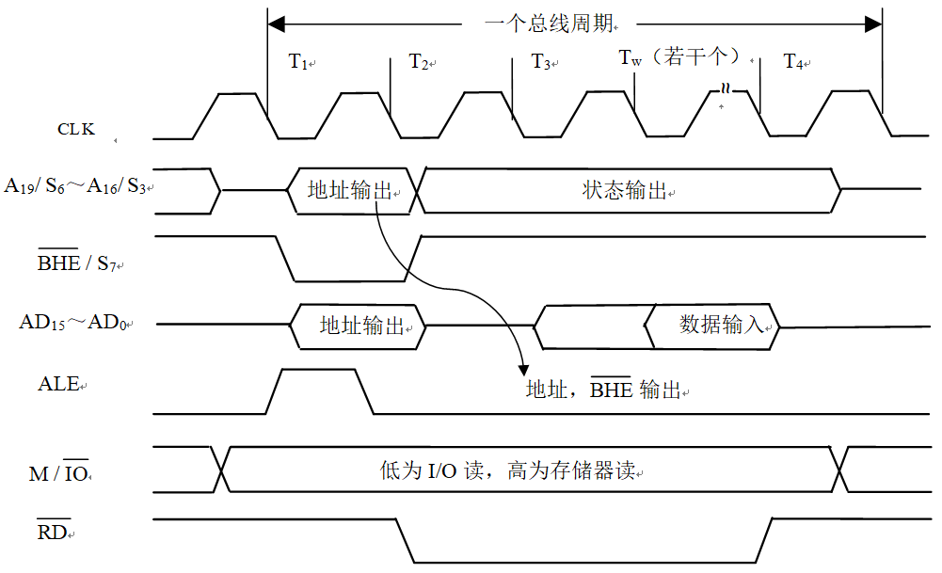
3.4 8086/8088 Hardware
Bus Timing on READ
one bus cycle
addr. output
Status output
addr. output
Data
Address
Output
0=I/O, 1=memory( 8086)

Slide 28
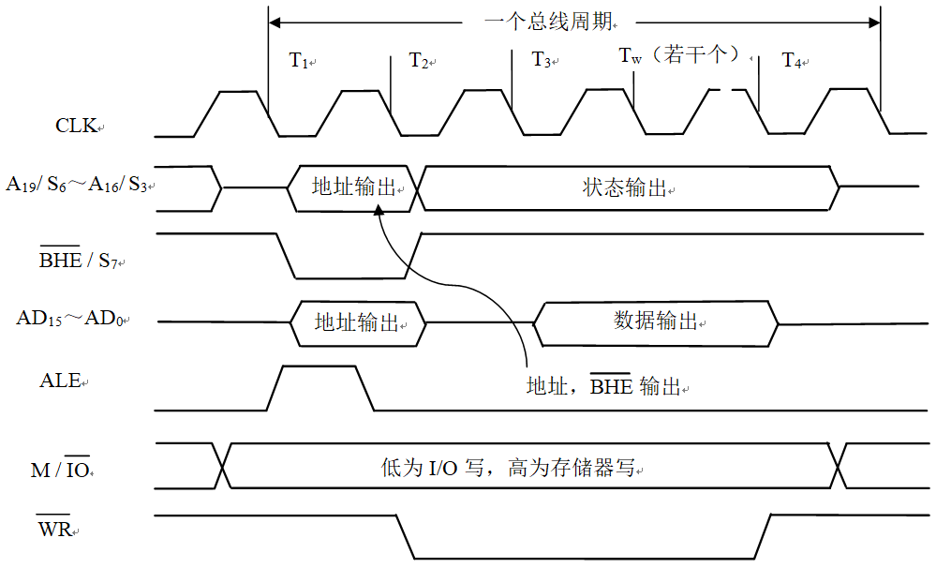
3.4 8086/8088 Hardware
Bus Timing on WRITE
one bus cycle
addr. output
Status output
addr. output
Data output
Address
Output
0=I/O, 1=memory( 8086)

Slide 29
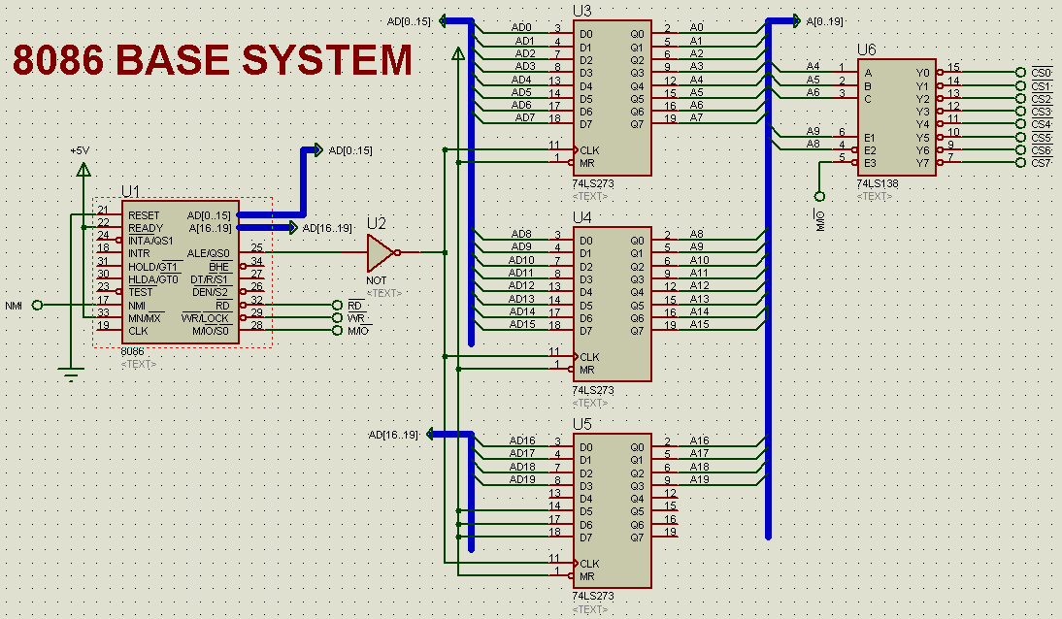
3.4 8086/8088 Hardware
8086 base system(in our experiment)
Connect with Device

Slide 30
3.5 Personal Computer I/O Map
I/O Port Address
  I/O Port number
    Registers in the I/O modules are numbered, this number is called the ports number
  I/O Ports Address
    I/O Ports Address = the base address of I/O module(Interface) + Ports number
  Note:
    There are many ports in one I/O module(Interface)
    One I/O port address can receive a variety of command, corresponding to multiple registers.

Slide 31
3.5 Personal Computer I/O Map
I/O Address Space in PC
  64k 8-bit port address space, or 32k 16-bit port address space, or 16k 32-bit port address space.
    00~0FFH is normally reserved for the computer system in main-board.
    100H~3FFH is normally reserved for the ISA bus.
    400H~0FFFFH are generally available for user application, main-board function and the PCI bus.
  Port address must be aligned.

Slide 32
3.5 Personal Computer I/O Map
I/O Address Space in PC
I/O chip | Address space
DMAC1 DMAC2 DMA page register | 0000-001FH 00C0-00DFH 0080-009FH
PIC1 PIC2 | 0020-003FH 00A0-00BFH
Timer PPI RT/CMOS RAM Coprocessor(Reserve) | 0040-005FH 0060-006FH 0070-007FH 00F0-00FFH
Notes:
DMAC: Direct Memory Access Controller
PIC: Programmable Interrupt Controller
PPI: Programmable Peripheral Interface

Slide 33
3.5 Personal Computer I/O Map
I/O Address Space in PC
I/O module(interface) | Address space
LPT1 LPT2 | 0370-037FH 0270-027FH
COM1 COM2 | 03F8-03FFH 02F8-02FFH
MDA CGA EGA/VGA | 03B0-03BFH 03D0-03DFH 03C0-03CFH
Floppy disk Hard disk | 03F0-03FFH 01F0-01FFH

Slide 34
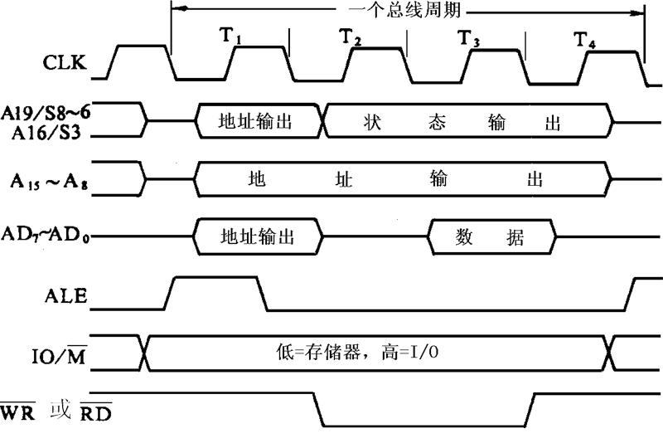
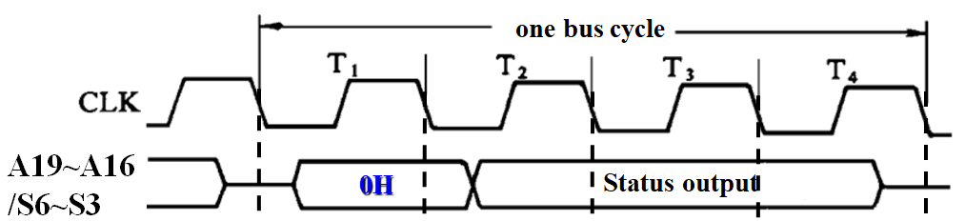
OUT 43H, AL
one bus cycle
A19~A16/S6~S3
0H
Status output
00H
AD15~AD0
43H
[AL]
M/IO
或
WR
CS₈₂₅₄

Slide 35
3.6 I/O Port Address Decoding
74LS138 decoder
1
15
A
Y₀
2
14
B
Y₁
3
13
C
Y₂
74LS138
12
Y₃
5
11
G_{2B}
Y₄
4
10
G_{2A}
Y₅
6
9
G₁
Y₆
Enable：
7
Y₇
G₁=1，G_{2A} =G_{2B}=0

Slide 36
3.6 I/O Port Address Decoding
Input |  | Output
G₁G_{2A}#G_{2B}# | C B A | Y₇ Y₆ Y₅ Y₄ Y₃ Y₂ Y₁ Y₀
1 0 0 | 0 0 0 | 1 1 1 1 1 1 1 0
1 0 0 | 0 0 1 | 1 1 1 1 1 1 0 1
1 0 0 | 0 1 0 | 1 1 1 1 1 0 1 1
1 0 0 | 0 1 1 | 1 1 1 1 0 1 1 1
1 0 0 | 1 0 0 | 1 1 1 0 1 1 1 1
1 0 0 | 1 0 1 | 1 1 0 1 1 1 1 1
1 0 0 | 1 1 0 | 1 0 1 1 1 1 1 1
1 0 0 | 1 1 1 | 0 1 1 1 1 1 1 1
0 X X | X X X | 1 1 1 1 1 1 1 1
X 1 X | X X X | 1 1 1 1 1 1 1 1
X X 1 | X X X | 1 1 1 1 1 1 1 1
True Table

Slide 37
3.6 I/O Port Address Decoding
74LS138 in Personal Computer
1
15
A₅
A
Y₀#
DMA CS#(8237)
2
14
A₆
B
PIC CS#(8259)
74LS138
13
3
A₇
C
Timer CS#(8253)
12
PPI CS#(8255)
5
11
A₈
G_{2B}#
≥1
WRTDMAPG#
4
10
A₉
G_{2A}#
WRTNMIREG#
6
9
≥1
AEN’#
G₁
7
Y₇#
WR#
Why I/O address of PIC is 0020H-003FH？

Slide 38
3.6 I/O Port Address Decoding
DMA
8259
8253
8255
…
…
00H
CPU
MEM
：
1FH
D7-D0
20H
Data BUS
：
A15-A0
Addr. BUS
3FH
Control BUS
40H
RD#
WR#
RD#
WR#
：
5FH
A5
15
D7-D0
D7-D0
60H
A
Y₀
：
A6
B
14
A7
74LS138
13
WR#
WR#
7FH
C
12
RD#
RD#
A8
G_{2B}#
11
A9
10
CS#
8259
CS#
G_{2A}#
9
A0
A0
3FFH
AEN#
G₁
7
Y₇
A1
A0
A1
A0
8253

Slide 39
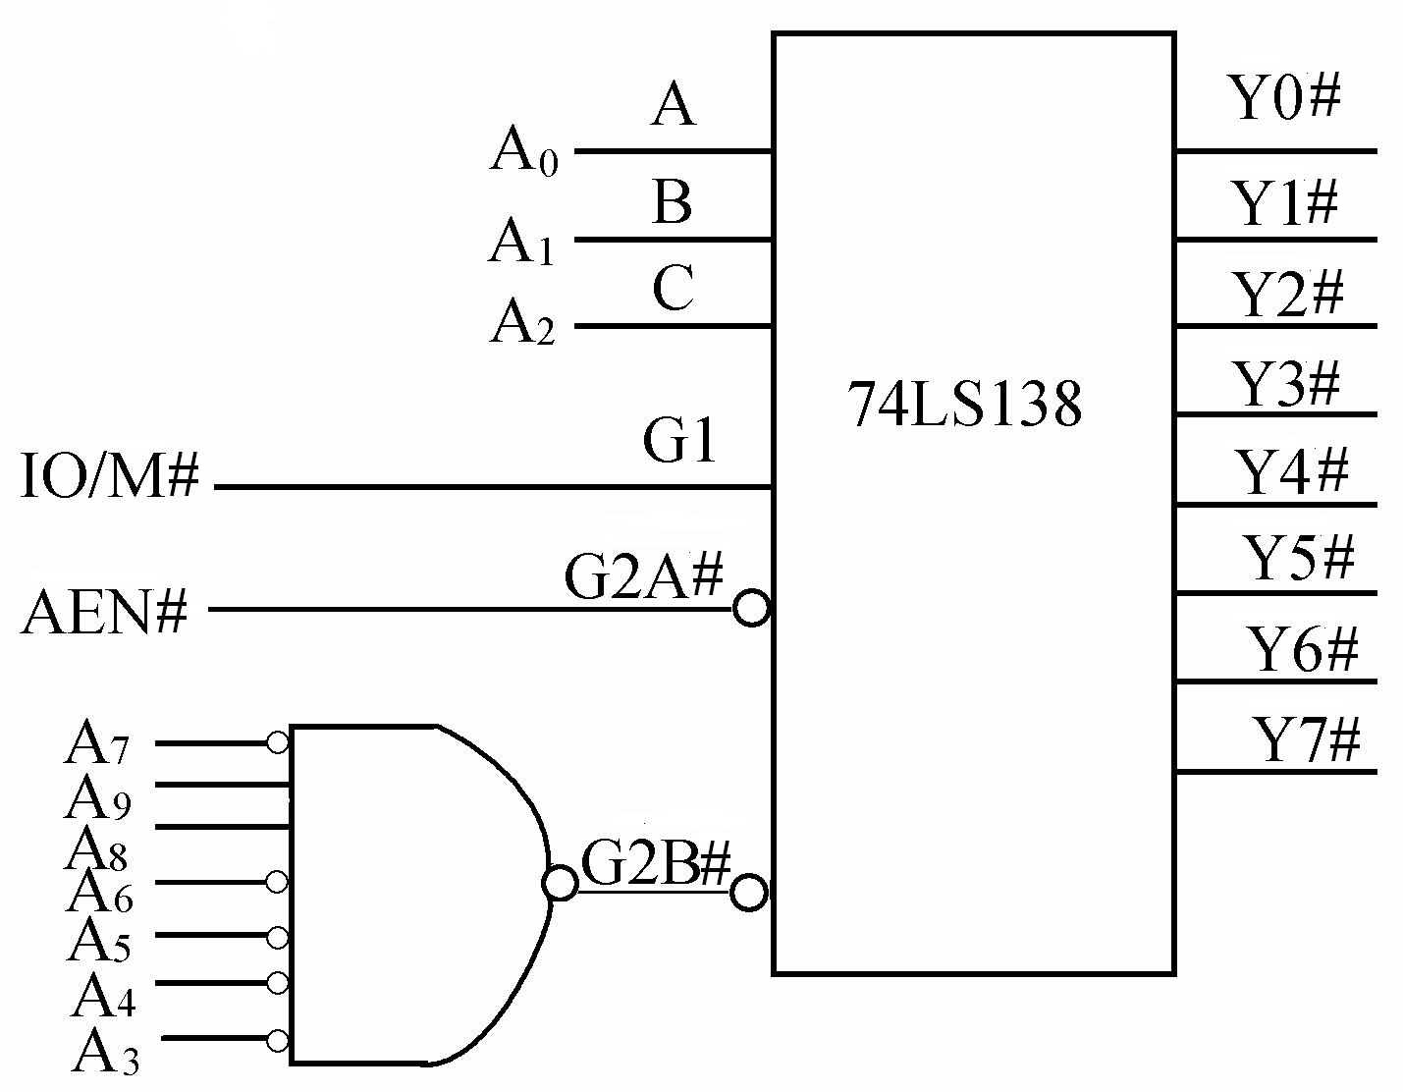
3.6 I/O Port Address Decoding
Exercise 1
?

Slide 40
3.6 I/O Port Address Decoding
Exercise 1
300H
301H
302H
303H
304H
305H
306H
307H

Slide 41
3.6 I/O Port Address Decoding
Exercise 2
__
1
Y₀
00~1FH
40~5FH
80~9FH
_________
100~11FH
_________
_________
_________
A
2
14
__
B
74LS138
13
__
3
C
12
__
5
11
G_{2B}
__
4
10
G_{2A}
6
9
AEN#
G₁
7
Y₇
Decode A9~A0 to complete the figure

Slide 42
3.6 I/O Port Address Decoding
A₉A₈A₇A₆A₅A₄A₃A₂A₁A₀
Exercise 2
Step 1 ? ? ? ? ? ×× ×××
Step 2 0 ? ? ? 0 ×× ×××
Step 3 0 C B A 0 × × ×××
1
15
A₆
A
Y₀
00~1FH
40~5FH
80~9FH
100~11FH
2
14
A₇
B
74LS138
13
A₈
3
C
12
C0~DFH
A₅
5
11
G_{2B}
#
A₉
4
10
G_{2A}
#
140~15HH
6
9
AEN#
G₁
180~19FH
7
Y₇
1C0~1DFH

Slide 43
3.6 I/O Port Address Decoding
Exercise 3
A
B
74LS138
Interface
Chip
C
G₁
Y₆
CS#
G_{2A} #
A₂
A₁
RD#
G_{2B} #
A₀
&
WR#
Decode A0~A9, let the port address of the interface chip is 260H, 262H, 264H, 266H, 268H, 26AH, 26CH, 26EH.

Slide 44

Exercise 3
A₉ A₈ A₇ A₆ A₅ A₄ A₃ A₂ A₁ A₀
0000
0010
0100
0110
1000
1010
1100
1110
260H
262H
264H
266H
268H
26AH
26CH
26EH
1 0 0 1 1 0
× × × 0
A₄
A
A₅
B
74LS138
Interface
Chip
A₆
C
A₉
G₁
Y₆
CS#
A₈
≥1
A₇
G_{2A} #
A₃
A₂
A₀
A₂
A₁
RD#
G_{2B} #
A₁
A₀
&
WR#

Slide 45
3.6 I/O Port Address Decoding
Exercise 4
A3
A
A4
B
Interface
Chip
74LS138
A5
C
A6
&
G₁
Y₂
CS#
A7
A8
G_{2A} #
≥1
A₀
A₀
A9
A₁
A₁
RD#
G_{2B} #
&
WR#
How many port are there in the interface chip? Give their address.

Slide 46
Exercise 4
A₉A₈A₇A₆A₅A₄A₃A₂A₁A₀
0 0 1 1 0 1 0 × 0 0
D0H D4H
4 ports
Address is
D1H or D5H
0 1
1 0
D2H D6H
1 1
D3H D7H
A3
A
A4
B
Interface
Chip
74LS138
A5
C
A6
&
G₁
Y₂
CS#
A7
A8
G_{2A} #
≥1
A₀
A₀
A9
A₁
A₁
RD#
G_{2B} #
&
WR#

